Slide 1
Enforced Modularity with Clients and Services
Chap 4.1

Slide 2
Outline
Client/service model
RPC
Case: DNS

Slide 3
The big picture
Consistency
Network
Atomicity
Naming
C/S
Virtualization
Modularity
Fault Tolerance
Abstraction
Layering
Notes:
Modularity is fundamental
Naming: glue of modules
C/S & virtualization are used for enforced modularity
Network, Atomicity and Consistency are based on modularity

Slide 4
Why enforced modularity?
Modularity itself is not enough
  Programmers make mistakes
  Mistakes propagate easily
  A way to strengthen the modularity is needed

Slide 5
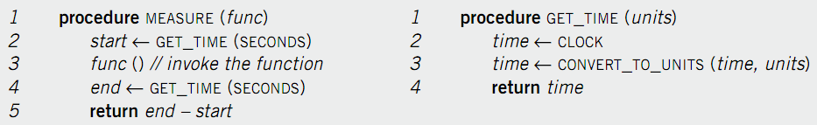
Modularity in the code
Modularity in the code
  E.g. hide CLOCK’s physical address
  E.g. hide time unit
  No need to change MEASURE on another computer, only change GET_TIME
  … but not enough

Slide 6
Soft modularity
Error leaks from one module to another
Function call
  Stack discipline
  Procedure calling convention

Slide 7
Potential problems in calling (1)
Errors in callee may corrupt the caller’s stack
  The caller may later compute incorrect results or fails
Callee may return somewhere else by mistake
  The caller may lose control completely and fail
Callee may not store return value in R0
  The caller may read error value and compute incorrectly
Caller may not save temp registers before the call
  The callee may change the registers and causes the caller compute incorrectly

Slide 8
Potential problems in calling - 2
Callee may have disasters (e.g. divided by 0)
  Caller may terminate too, known as fate sharing
Callee may change global variable that it shouldn’t
  Caller and callee may compute incorrectly or fail altogether
  Even other procedures may be affected
Procedure call contract provides only soft modularity
  Attained through specifications
  No way to force the interactions among modules to their defined interfaces

Slide 9
Type-safe language
Using type-safe language (e.g. Java)
  Can beef up to a certain extent
    Programs can only write to memory in accordance with their type
    Cannot overwrite arbitrary memory or corrupt the stack
  Still insufficient for complete system
    Not all modules are in type-safe language
    Callee use up all the resourses
    Fate sharing (e.g. infinite loop)

Slide 10
Sidebar: Why still using C?
  The systems programmer requires an intuitive model of what is happening on the machine at the source code level.
  Kernel programmers already operate at (or slightly beyond) the outer limit of systemic complexity that can be maintained in a programmer’s head
  Transparency gave way to abstraction, and then to opacity

Slide 11
Enforced modularity is needed
Using external mechanism
  Limits the interaction among modules
  Reduces the opportunities for propagation of errors
  Allows verification that a user uses a module correctly
  Prevent an attacker from penetrating the security of a module

Slide 12
C ---- S

Slide 13
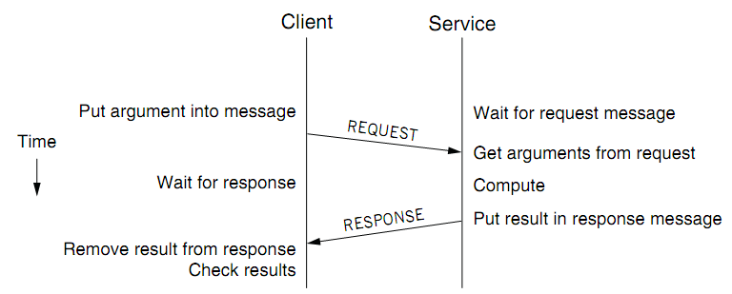
Client/Service organization
Limit interactions to explicit messages
  Client: request; service: response or reply
  On different computers, connected by a wire
    Chap 5 will explain how to get them into one computer

Slide 14
Client program MEASURE and GET_TIME
1 procedure measure (func)
2 send_message (NameForTimeService, {"Get time",
convert2external(seconds)})
3 response ← receive_message (NameForClient)
4 start ← convert2internal (response)
5 func () // invoke the function
6 send_message (NameForTimeService, {"Get time",
convert2external(seconds)})
7 response ← receive_message (NameForClient)
8 end ← convert2internal (response)
9 return end – start

Slide 15
Back to the example
Implement MEASURE and GET_TIME with C/S
  On different computer
  Marshaling: big-endian & little-endian converting
C/S model
  Separates functions (abstraction)
  Enforces that separation (enforced modularity)
  Reduce fate sharing (client return, if server not responds)
    but not eliminate it
  Very Clear interface
Notes:
Occam’s Razor.

Slide 16
Multiple clients and services
One services --→ multiple clients
One client use -→ several services
A single module --→ both client and service
  Printer as a service for printing request
  Also a client of the file service

Slide 17
Trusted intermediaries
Service as Trusted 3rd Party
  Run critical procedures as a service
  E.g. a file service to keep clients’ file distinct, email service
  Enforces modularity among multiple clients
  Ensures that a fault in one client has limited effect on another client
Thin client computing
  Simplify clients by having the trusted intermediary provide most functions
  Only the trusted intermediaries run on powerful computers
  What if the powerful computers fail…

Slide 18
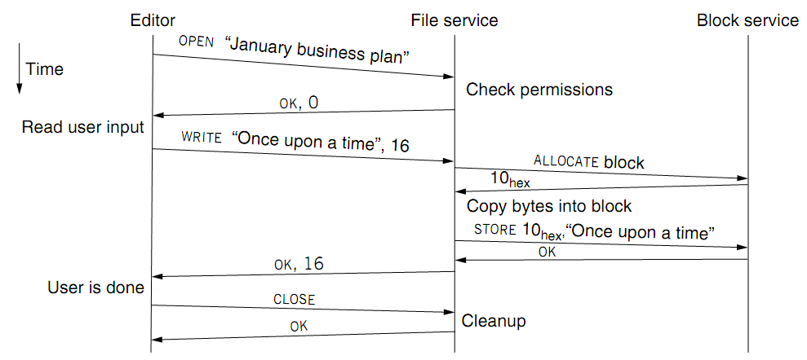
A simple example service

Slide 19
RPC
RPC （Remote Procedure Call)
  Allow a procedure to execute in another address space without coding the details for the remote interaction
RPC History
  Idea goes back in 1976
  Sun’s RPC: first popular implementation on Unix
    Used as the basis for NFS
RMI (Remote Method Invocation)
  Object-oriented version of RPC, e.g. in Java

Slide 20
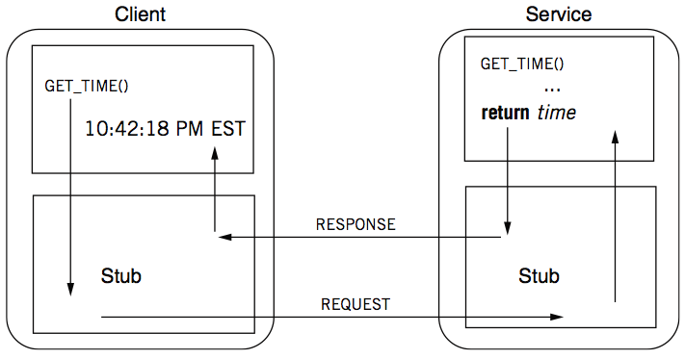
RPC calling process
Message send/receive
  SEND_MESSAGE(NameForTimeService, {“Get time”, unit})
  RECEIVE_MESSAGE(NameForTimeService)

Slide 21
Measure and the stub
procedure measure (func)
2 start ← get_time (seconds)
3 func () // invoke the function
4 end ← get_time (seconds)
5 return end – start
------------------------------------------------------------------------------
7 procedure get_time (unit) // the client stub for get_time
8 send_message (NameForTimeService, {"Get time", unit})
9 response ← receive_message (NameForClient)
10 return convert2internal (response)

Slide 22
RPC stub
Client stub
  Marshal the arguments into a message
  Send the message
  Wait for a response
Service stub
  Wait for a message
  Unmarshal the argument
  Call the procedure (e.g. GET_TIME)
Stub
  Hide marshaling and communication details

Slide 23
Automatic stub generation
  Automatic generation
  Generate stubs
  from an interface defination

Slide 24
RPC != PC
Different in three ways
  RPCs can reduce fate sharing
    Won’t crash
    Set a time-out for message lost or service failure
  RPCs introduce new failures: no response
    Three implementation strategies:
      At-lease-once
      At-most-once
      Exactly-once
  RPCs take more time
    Stub itself may cost more than a service

Slide 25
RPC Semantics in the
Presence of Failures
Five different classes of failures that can occur in RPC systems:
The client is unable to locate the server.
The request message from the client to the server is lost.
The server crashes after receiving a request.
The reply message from the server to the client is lost.
The client crashes after sending a request.
Tanenbaum & Van Steen, Distributed Systems: Principles and Paradigms, 2e, (c) 2007 Prentice-Hall, Inc. All rights reserved. 0-13-239227-5

Slide 26
RPC: failure handling
1. At least once
  Client keeps resending until server responds
  Only OK without side effects
2. At most once
  Client keeps resending (may time-out)
  Server remembers requests and suppress duplicates
3. Exactly once
  This is often what we really want
  Hard to do in a useful way, later in Chap-8 and 10
Most RPC system do #1 or #2

Slide 27
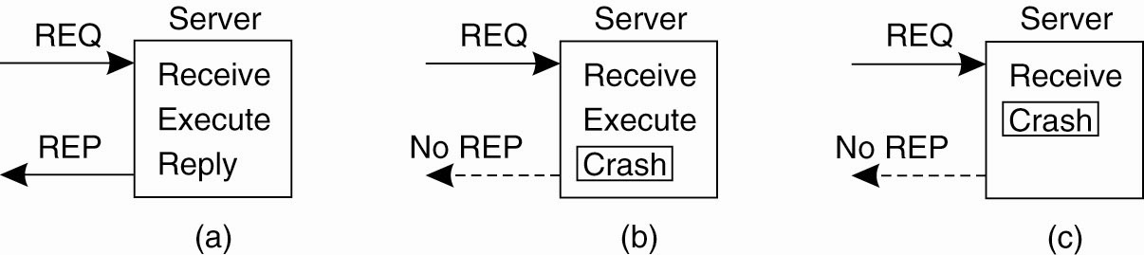
Server Crashes (1)
Figure 8-7. A server in client-server communication.
(a) The normal case.
(b) Crash after execution.
(c) Crash before execution.

Slide 28
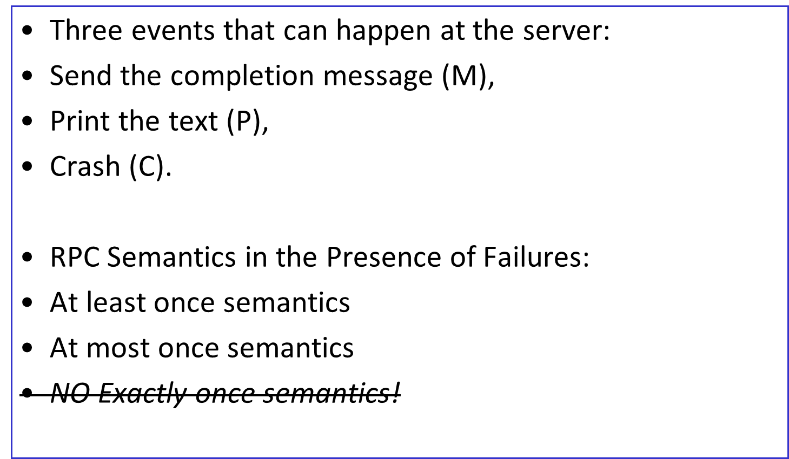
Server Crashes (2)

Slide 29
Server Crashes (3)
These events can occur in six different orderings:
M →P →C: A crash occurs after sending the completion message and printing the text.
M →C (→P): A crash happens after sending the completion message, but before the text could be printed.
P →M →C: A crash occurs after sending the completion message and printing the text.
P→C(→M): The text printed, after which a crash occurs before the completion message could be sent.
C (→P →M): A crash happens before the server could do anything.
C (→M →P): A crash happens before the server could do anything.

Slide 30
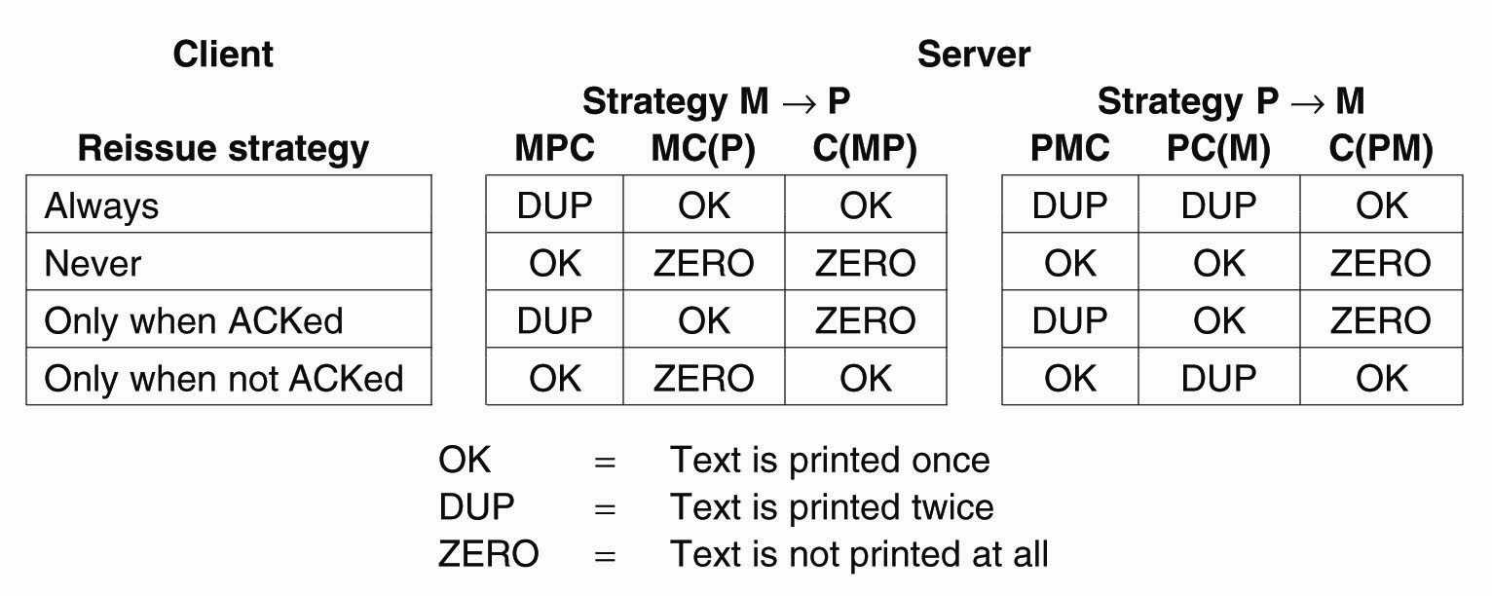
Server Crashes (4)
Figure 8-8. Different combinations of client and server
strategies in the presence of server crashes.
Tanenbaum & Van Steen, Distributed Systems: Principles and Paradigms, 2e, (c) 2007 Prentice-Hall, Inc. All rights reserved. 0-13-239227-5

Slide 31
Lost Reply Messages
1 request once more
asking for the first 1024 bytes of a file has no side effects
Vs
transfer a million dollars from one account to another.
the client assign each request a sequence number.

Slide 32
Other differences
Language support
  Some features don’t combine well with RPC
    Inter procedure communicate through global variable
  Data structure that contains pointers
    Different binding of address on client and server

Slide 33
Communicating through an intermediary
Asynchronization between sender and receiver
  E.g. E-mail service
  Need an intermediary for buffering
Three designs opportunities
  Push or pull
  Decouple by indirection: president@whitehouse.com
  When and where to duplicate: group messages
Publish/subscribe: mailing list, chat room, RSS, BBS

Slide 34
Case: DNS
DNS (Domain Name Service)
  A C/S application of naming scheme
  A general purpose name management and name resolution system
History
  Before DNS
    HOSTS.TXT on every computer
  1984, four Berkeley students wrote BIND
    Berkeley Internet Name Domain, on UNIX
    Still the dominant DNS software in use

Slide 35
DNS
DNS features
  Hierarchical distribution of name
  Rapid response to request
  Excellent scalability for the Internet
  fault tolerant

Slide 36
DNS model
The telephone book model
  Give each user a copy of mapping file
  Used for nearly 20 years until late 80s
The central directory service model
  The central server is in charge of all name assignment
  Easy for update, but is performance bottleneck
The distributed directory service model
  Many servers, each resolves some subset of domain names
  DNS uses this model

Slide 37
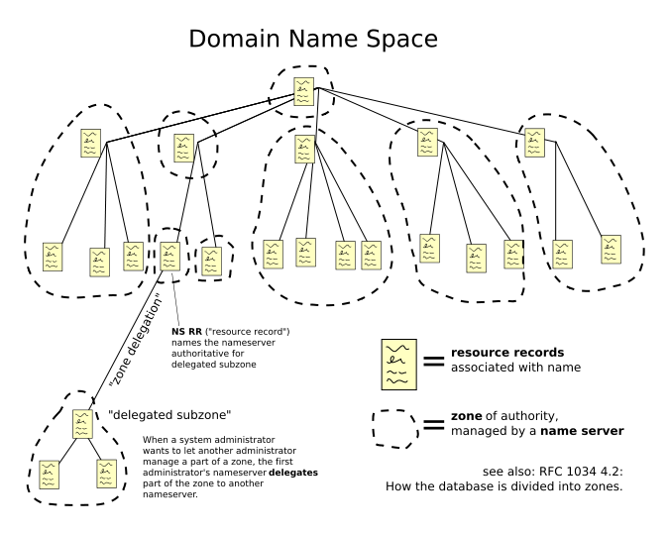

Slide 38
DNS request process
a.root.net
a.root.net
names.edu
names.edu
NS: for edu
ns.iss.edu
ns.iss.edu
NS: for
Scholarly.edu
ginger.
Scholar.edu
ginger.
Scholar.edu
ginger.
Scholar.edu
AP: for
ginger.Scholar.edu
Name client
Name client

Slide 39
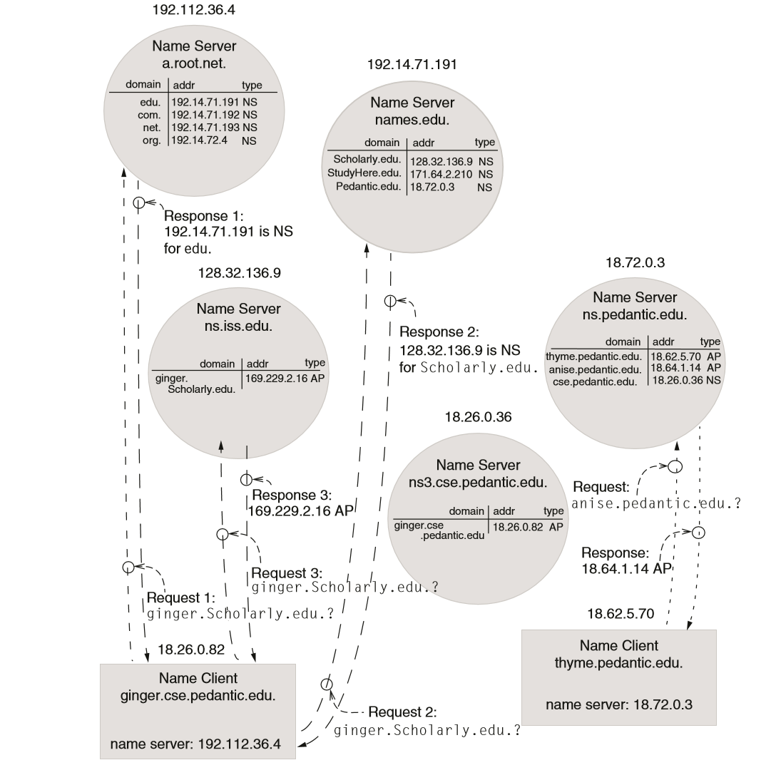
Chap 4.1

Slide 40
Elaborations
Root name server is not necessary to resolve the initial request
  Any convenient name server
  If no record, just returns address of the root server
Some server offer recursive name service
  Takes on the responsibility for resolving the name
  Performance enhancement with next feature
Cache records
  What if cache go out of date? Expiration period
  The eventual consistency memory model (Chap-10)

Slide 41
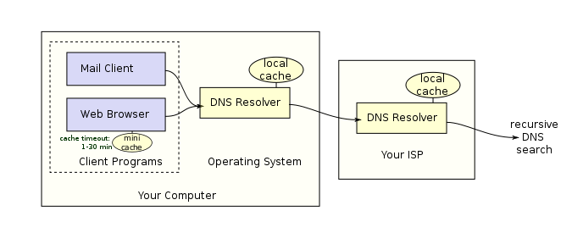
DNS resolver
202.120.224.6

Slide 42
Hierarchical name management
Distributing responsibility
  If pedantic.edu is added in edu namer server, then any record with “.pedantic.edu” can be added
  Can create lower-level naming domains
    E.g. “cse.pedantic.edu”

Slide 43
Other features of DNS
At least two identical replica servers
  80s replicas of the root server
  Replicas are placed separated around the world
Organization’s name server ( Fudan)
  Several replica in campus
    To enable communications within the organization
  At least one out of the campus
    202.120.224.6
Return value is a list of address
  Let the client chose

Slide 44
Other features of DNS
Robust
  The job of a DNS server is simple
  Stateless
  A cheap PC is OK for large organization
Synonyms by indirect names
  Bind new name and old name
  1 computer appears to be in 2 domains （ widely different ）

Slide 45
Name discovery in DNS
A client discovers a nearby DNS
  Name discovery broadcast to ISP at first time
  Ask network manager
A user must discover the domain name of a service
  Ask by email, Google
The resolving system must discover an extension for unqualified domain names
  Extend by default context, e.g. extend “library” to “library.pedantic.edu”

Slide 46
DNS security
DNS authentication
  Cache inconsistency
DNS hijack
  Cutting the binding between name and IP
  Solution: /etc/hosts, dnsmasq, OpenDNS, etc.
DNS DoS
  BAOFENG.com

Slide 47
Windows fs
Linux ext2
Linux ext3
Hadoop distributed file system
Linux 文件 缓冲机制
Redis机制
memcache
Chap 4.1

